Slide 1
KD TREES AND QUAD TREES APPLICATIONS
GROUP NO 16
Bhargav Pawar (46)
Himanshu Pandey (20)
Nishant Bhat (41)
Abhijit Gawai (18)
Shyam Kawale (27)

Slide 2
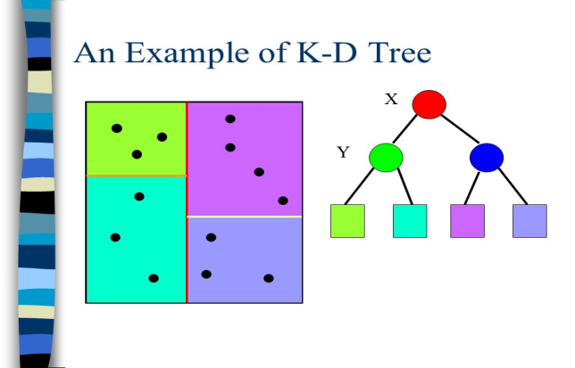
What exactly are k-d trees?
In computer science, a k-d tree (short for k-dimensional tree) is a space-partitioning data structure for organizing points in a k-dimensional space.
k-d trees are a useful data structure for several applications, such as searches involving a multidimensional search key.
It is a tree used to store spatial data-
Nearest neighbor search
Range queries
Range Look up
k-d tree are guaranteed log2 n depth where n is the number of points in the set.

Slide 3
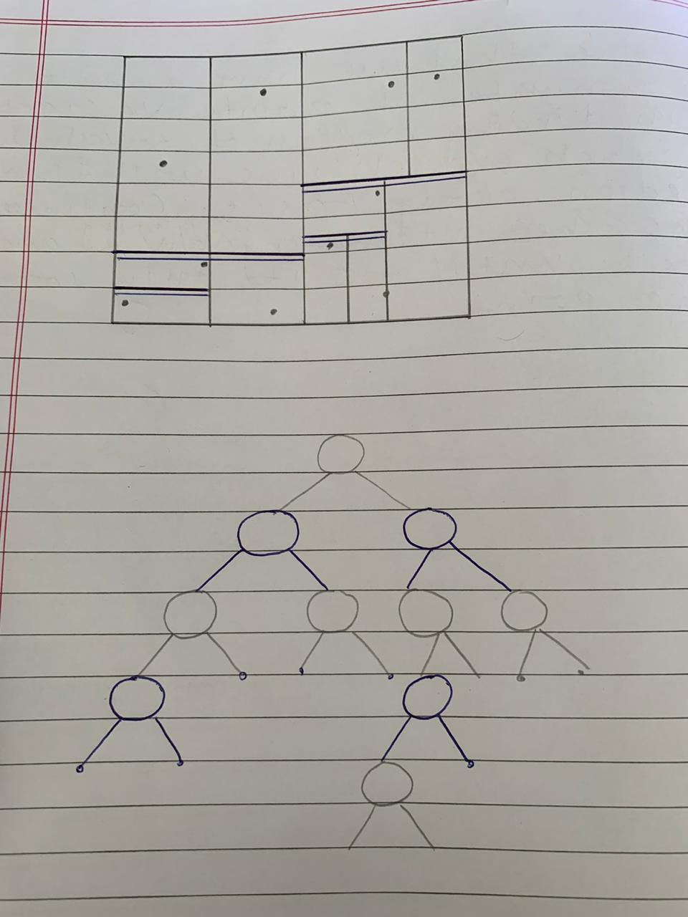
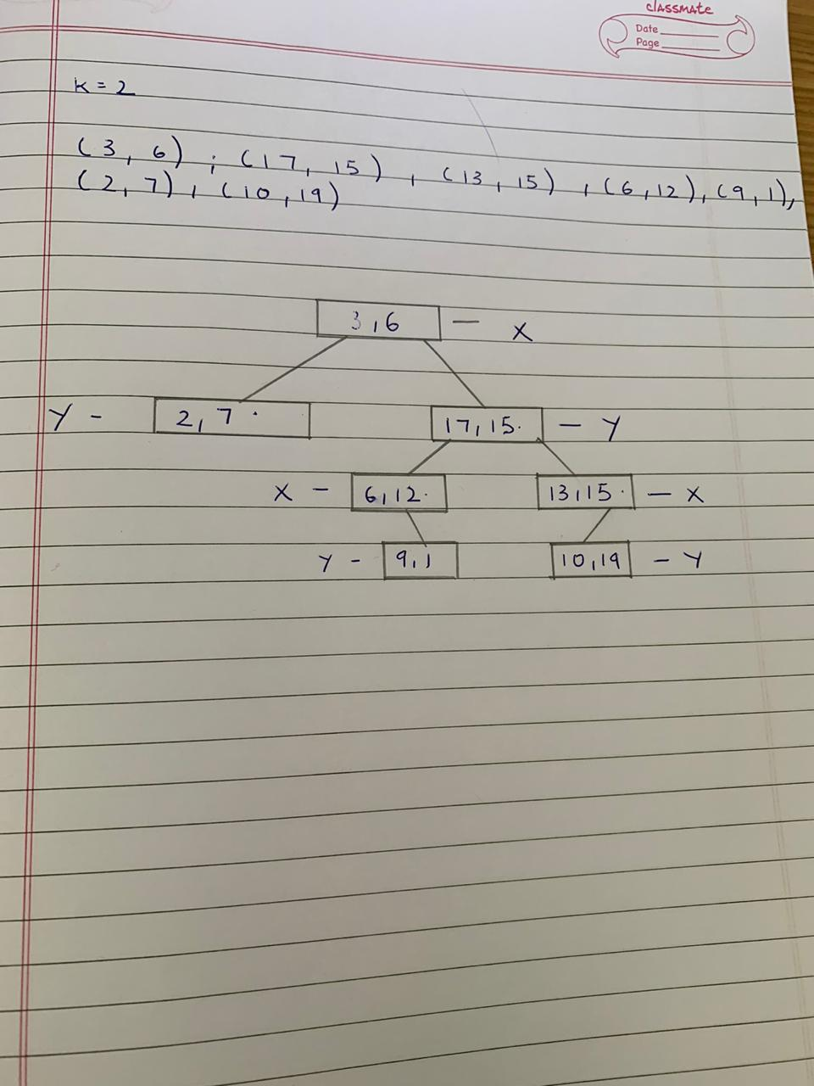

Slide 4
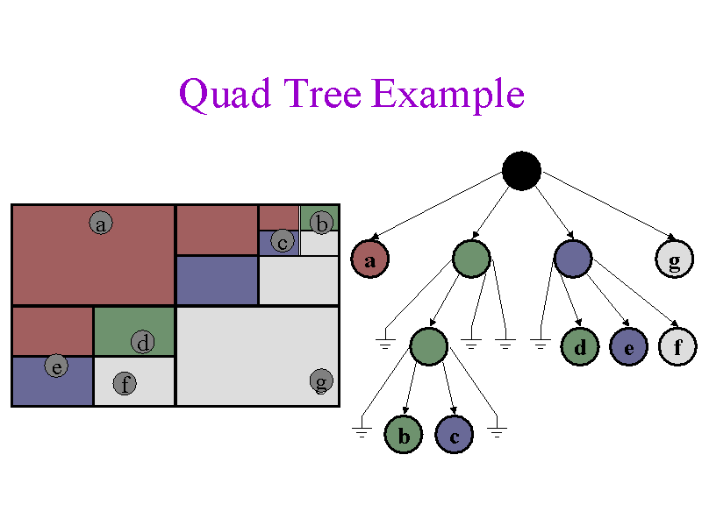
What exactly are quad trees?
A quadtree is a tree data structure in which each internal node has exactly four children.
In a quadtree, each node represents a bounding box covering some part of the
A space being indexed, with the root node covering the entire area.

Slide 5
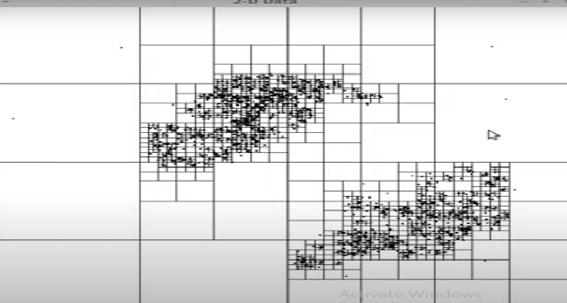

Slide 6
Basic applications of k-d trees:
Nearest neighbor search.
Database queries involving a multi-dimensional search key.
n body problems.
Colour reduction.

Slide 7
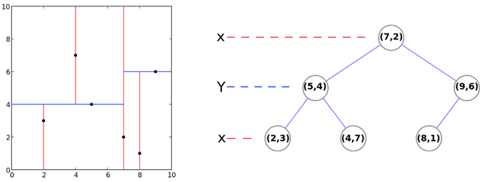
Nearest neighbor search
The nearest neighbor search (NN) algorithm aims to find the point in the tree that is nearest to a given input point.
This search can be done efficiently by using the tree properties to quickly eliminate large portions of the search space.

Slide 8
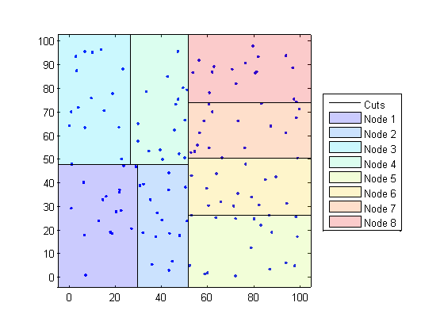
Database queries involving a multi-dimensional search key.
A range search searches for ranges of parameters.
For example, if a tree is storing values corresponding to income and age, then a range search might be something like looking for all members of the tree which have an age between 20 and 50 years and an income between 50,000 and 80,000.
Since k-d trees divide the range of a domain in half at each level of the tree, they are useful for performing range searches.

Slide 9
N body problems
It efficiently simulates the movements of a collection of objects moving under mutual gravitational attraction.
The naive method would involve computing the gravitational force between an object due to every other object in order to simulate its motion under gravitational attraction. Moreover, we would have to do it for every object which would take O(n^2) time.
Using k-d trees, however, we can partition the space and for each subdivision of space, figure out its total effect on the rest of space. Below is the pseudo code of the algorithm.

Slide 10
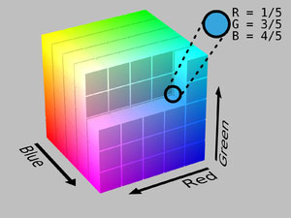
Color reduction
This method can be used to pick up the colors which are used most often.
A more efficient method, however, could represent colors in terms of their RGB values and construct a 3 dimensional k-d tree in order to divide the space containing all the colors of the image.
The construction of the k-d tree would stop when the count of the leaf nodes becomes equal to 256.
The average of the RGB value of each of the 256 partitions could then be used to get a 256 color palette for the full color image.

Slide 11
Applications of quad trees.
Image Processing
Spatial Indexing
Mesh generation
Collision detection

Slide 12
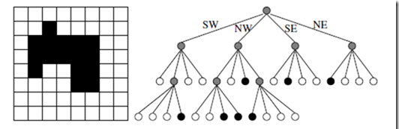
Image processing
Set operations of union and intersection can be done simply and quickly.
The image union (also called overlay) of two input images produces an image wherein a resultant is union of the pixels of the input images in that same location.
Resultant: black + (any color) = black
white + white = white
So, rather than do the operation pixel by pixel, we can compute the union more efficiently by leveraging the quad tree's ability to represent multiple pixels with a single node.
The algorithm works by traversing the two input quadtrees Q1 and Q2, while building the output quadtree RQ.

Slide 13
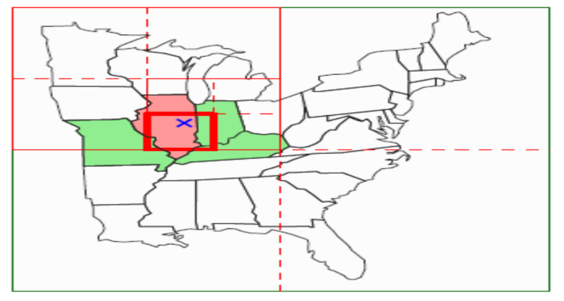
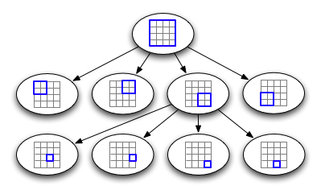
Spatial Indexing:
Spatial indexing is an increasingly important area of geo-spatial application design.
Example:
1.Ride-sharing apps(Uber) need to be able to track the location of cars in near real-time, and provide user updates via extremely fast geo-queries.
2. Facebook let you know when your friends are nearby.
The spatial index allows special geometric queries to be executed efficiently.
example-NN(nearest neighbour), Geo-distance Range Queries.
Fig:A

Slide 14
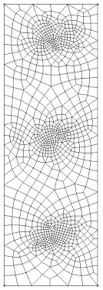
Mesh generation
Sometimes, a regular mesh is not good enough.
A compromise between mesh size and computational speed is needed.
Quad trees can be used to generate non-uniform meshes
Typically, a mesh can be simply represented with two types of components, i.e., the list of nodes and the list of elements.
The list of nodes usually holds the index, coordinates, and attribute of each node, while the list of elements stores the index of each element, the indices (not the coordinates) of nodes forming the element, and the attribute of each element.

Slide 15
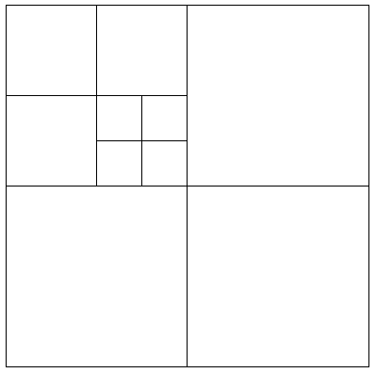
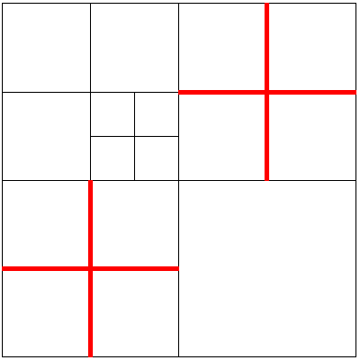
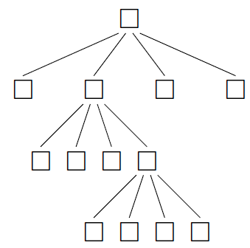
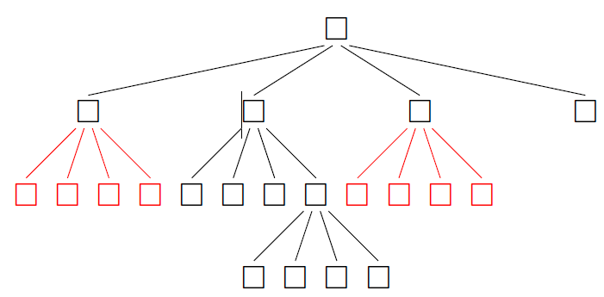
Unbalanced Quad Tree
Balanced Quad Tree

Slide 16
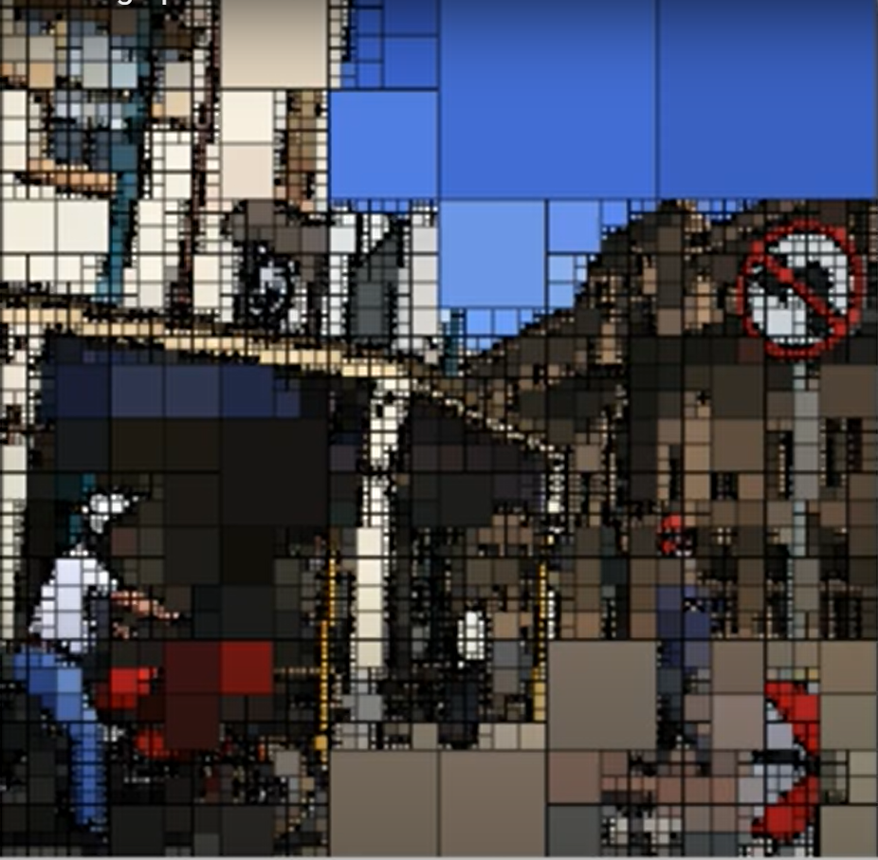

Slide 17
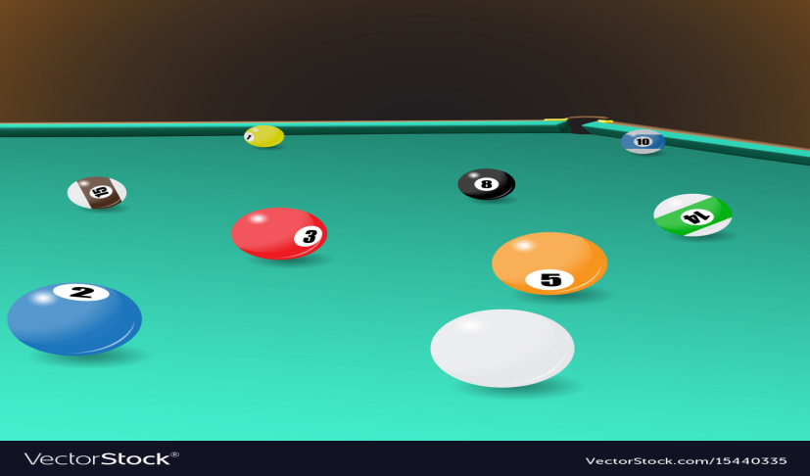
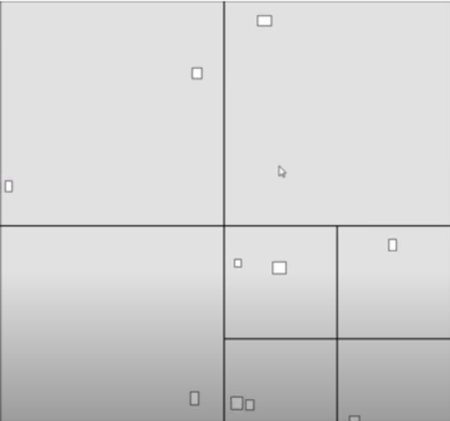
Collision detection
In physical simulations, video games and computational geometry, collision detection involves algorithms for checking for collision, i.e. intersection, of two given solids.
Collision detection is widely used in games.
Without it, for instance, characters would go through walls. Pool simulations clearly require a good collision detector.
A Brute Force algorithm for Collision Detection would take O(n²) time. (Too slow!) •
Creating a Quad tree allows us to analyze only adjacent squares,
reducing the number of comparisons greatly.

Slide 18
thankyou
GROUP NO 16

